Slide 1
Supported Decision-Making

Slide 2
Supported Decision-Making
Thank You!

Slide 3
S&P GLOBAL FOUNDATION
We support inclusive sustainable economies and thriving global communities.
S&P GLOBAL FOUNDATION
We support inclusive sustainable economies and thriving global communities.
Supports inclusive sustainable economies and thriving global communities.
1). Bridge the Global Skills Gap,
2). Create an Inclusive Economy, and
3). Promote a Sustainable Environment.
4). Global disaster relief efforts with a focus on resiliency.

Slide 4
What is Supported Decision-Making (SDM)
Colorado State Statute defines:
"Supported decision-making" means the way an adult with a disability or diminished capacity has made or is making his or her own decisions by using friends, family members, professionals, and other people he or she trusts to:
(a) Help understand the issues and choices;
(b) Ask questions;
(c) Receive explanations in language he or she understands;
(d) Communicate his or her decisions to others if necessary; or
(e) Facilitate the exercise of decisions regarding his or her day-to-day health, safety, welfare, or financial affairs.

Slide 5
Who uses SDM?
All of us use supported decision-making in a less formulized process over the course of our daily lives
SDM provides this natural, community-based methodology to aid individuals in determining the trajectory of their own lives
Supported Decision-Making may be used on a case-by-case basis and can be advantageous for:
Individuals with Intellectual and Developmental Disabilities
Individuals struggling with mental health diagnosis
Individuals who are elderly
In short, SDM may be good for any individual whose family may be considering a Guardianship or other, more restrictive alternative
SDM is also an excellent practice to begin with young children who may have disabilities, to help them adjust to making their own decisions, with support from their community at a young age

Slide 6
Why Does SDM Matter?
To understand this, we must first understand the history of disability in the United States

Slide 7
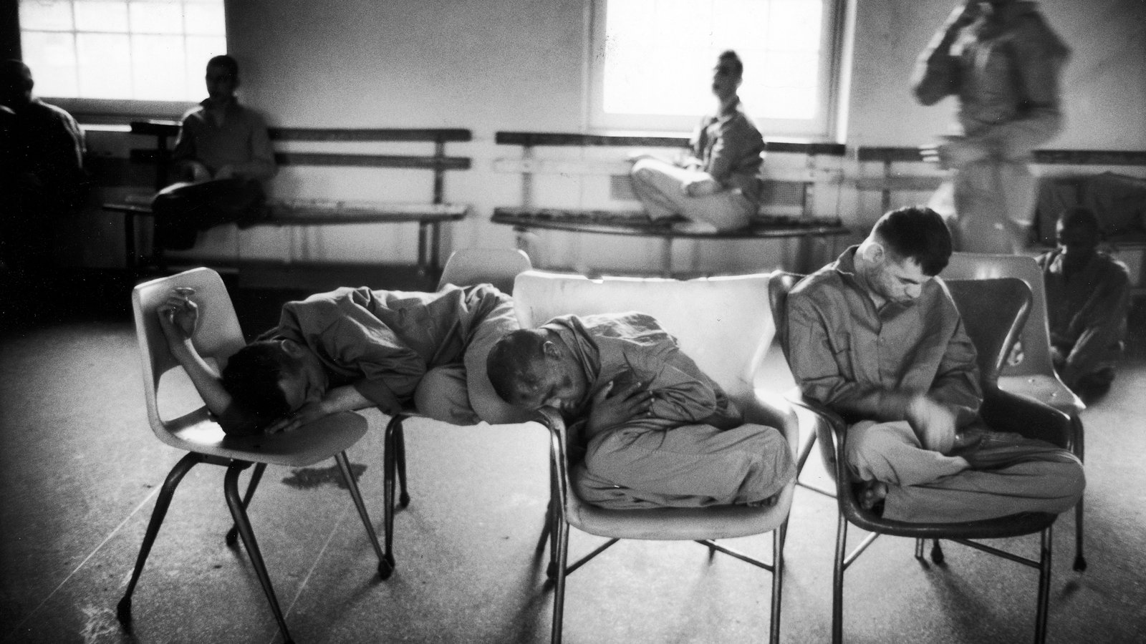
Institutional Care
For most of modern, western history, people with I/DD lived in institutional care settings
Institutions created almost no opportunity for self-determination
Decisions were made for a person, even those most personal such as:
Reproductive rights and care decisions
Financial decisions
The right to employment
Many others
In the 1960’s, growing awareness, spurred on by the atrocities of the Willowbrook State School pushed society towards change

Slide 8
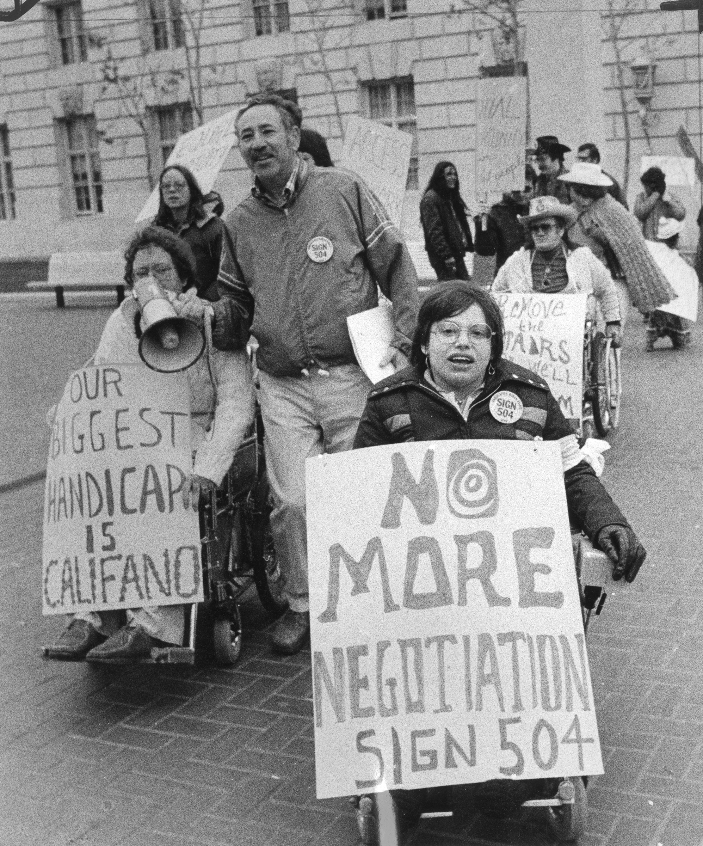
The Shift Towards Community Living
Disability Right’s Advocates (many of whom had disabilities themselves) began to fight for their right to access their communities
State systems of support recognized the importance of serving people in community
As people with disabilities were welcomed into workplaces, neighborhoods, and schools, it became increasingly apparent that their potential was far greater than societal expectations of the past had realized
Archaic systems (many of which are still in place) built to protect and keep people with disabilities outside of the public eye began to fall with the hard work of advocates

Slide 9
What SDM IS
What SDM IS NOT
A supportive practice that presumes the capacity of people with disabilities
A skillset that can move and grow with the person with disabilities
Voluntary
A way to help someone come to their own decision about what they feel is best for their own lives
A practice that allows each person a right to risk, make mistakes, and learn from them
A way to presume the incompetence of a person with disabilities
A prescriptive set of actions
Ordered
A way to coerce a person with a disability into making a decision that someone else thinks is best for them
An opportunity to protect a person with disabilities from a perceived threat, even if they do not with so be protected from this threat

Slide 10
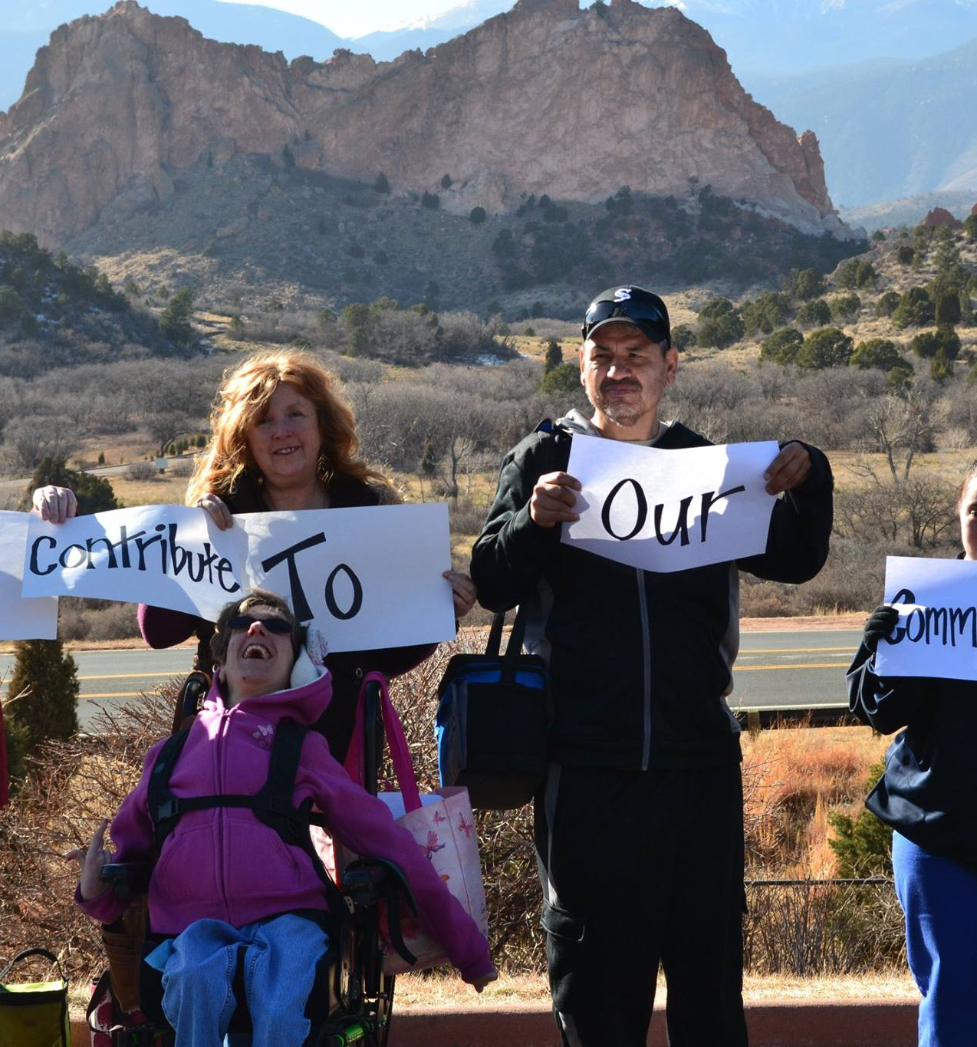
Supportive Decision-Making is Empowering
By using SDM, the individual retains his or her legal rights
SDM increases self-esteem, self-worth
SDM allows for personal growth and experiences
SDM reduces stigma
Using SDM means that individuals with disabilities are viewed as more capable of contributing to society because they are in charge of their own lives

Slide 11
Who can be a supporter?
A member of the supported decision-making community can be any member of the community including:
Caregiver
Friend
Mentor
Religious advisor
Sibling
Provider
What matters is that the supporter is chosen by the person with a disability and is a trusted person who understands the interest, values, and preferences of the person with a disability
Most people have between 4 and 7 supporters
The person with disabilities may choose which life decisions they want each member of their supportive community to help them make
Ex. I may want my Priest to help me make decisions about my relationships or medical procedures, but may not want him involved in my financial decisions

Slide 12
What do Supporters Do?
Supporters assist the person with the disability so he or she can make his or her own decisions. Supporters help the person understand the choices at hand, and review options — the pros and the cons — of the pending issue. The supporters may also assist the person in communicating his or her intention to others. Supporters may attend appointments or other meetings with the individual with the disability if the person with the disability wants the supporter there.

Slide 13
Who makes the ultimate decision?
ALWAYS, ALWAYS the FINAL DECISION is left to the person with the disability. Supporters may agree or disagree with a decision, but must respect that they are only there to provide advice and not to decide on behalf of the person with the disability

Slide 14
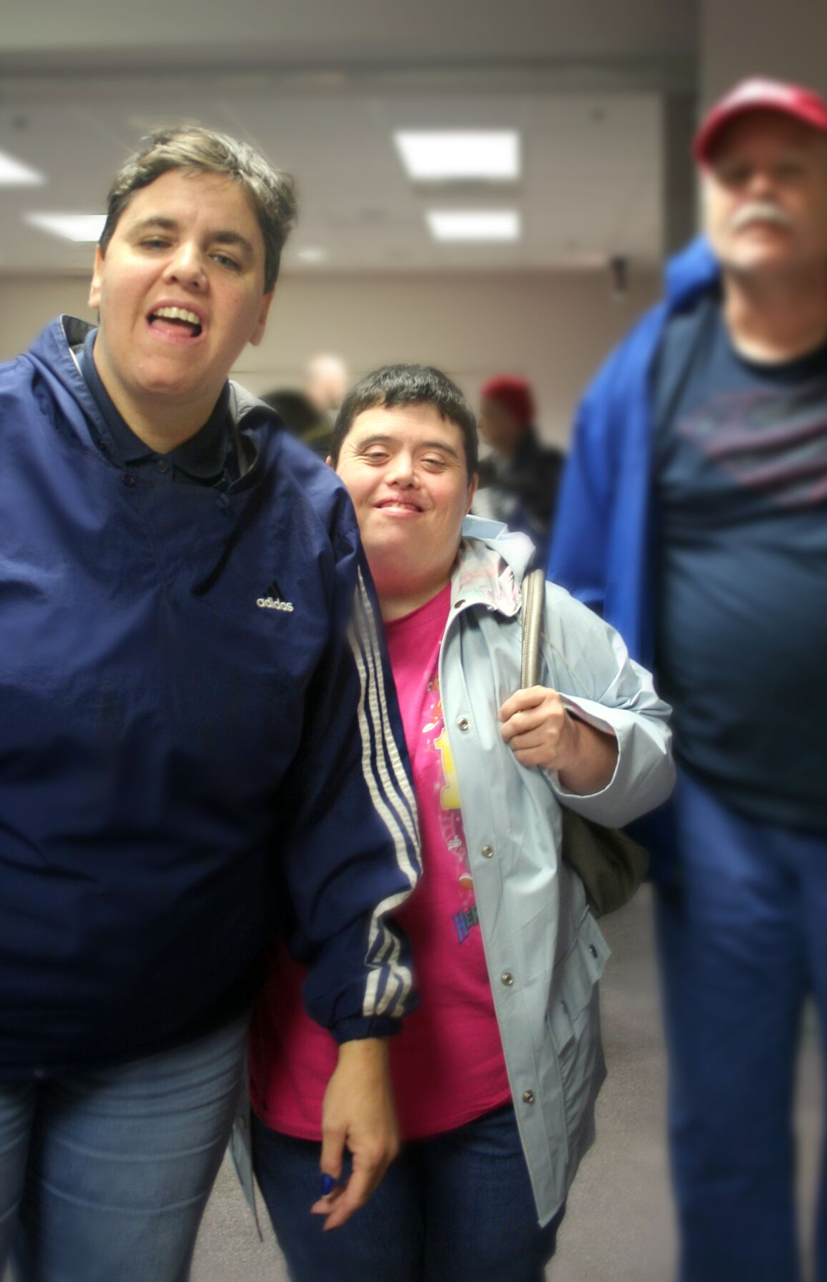
What about a person under guardianship?
If the person with disabilities is in a guardianship agreement, the guardian may deem it appropriate for the person to experiment with supported decision-making.
This may help to encourage the person with disabilities to begin to foster a sense of independence and self-determination, which are both key to our quality of life and to our understanding of our place in the world
It is important that the guardian understand the difference in the roles of guardian and supporter
It is never appropriate for a guardian to use their authority to coerce a person with disabilities in the supported decision-making process

Slide 15
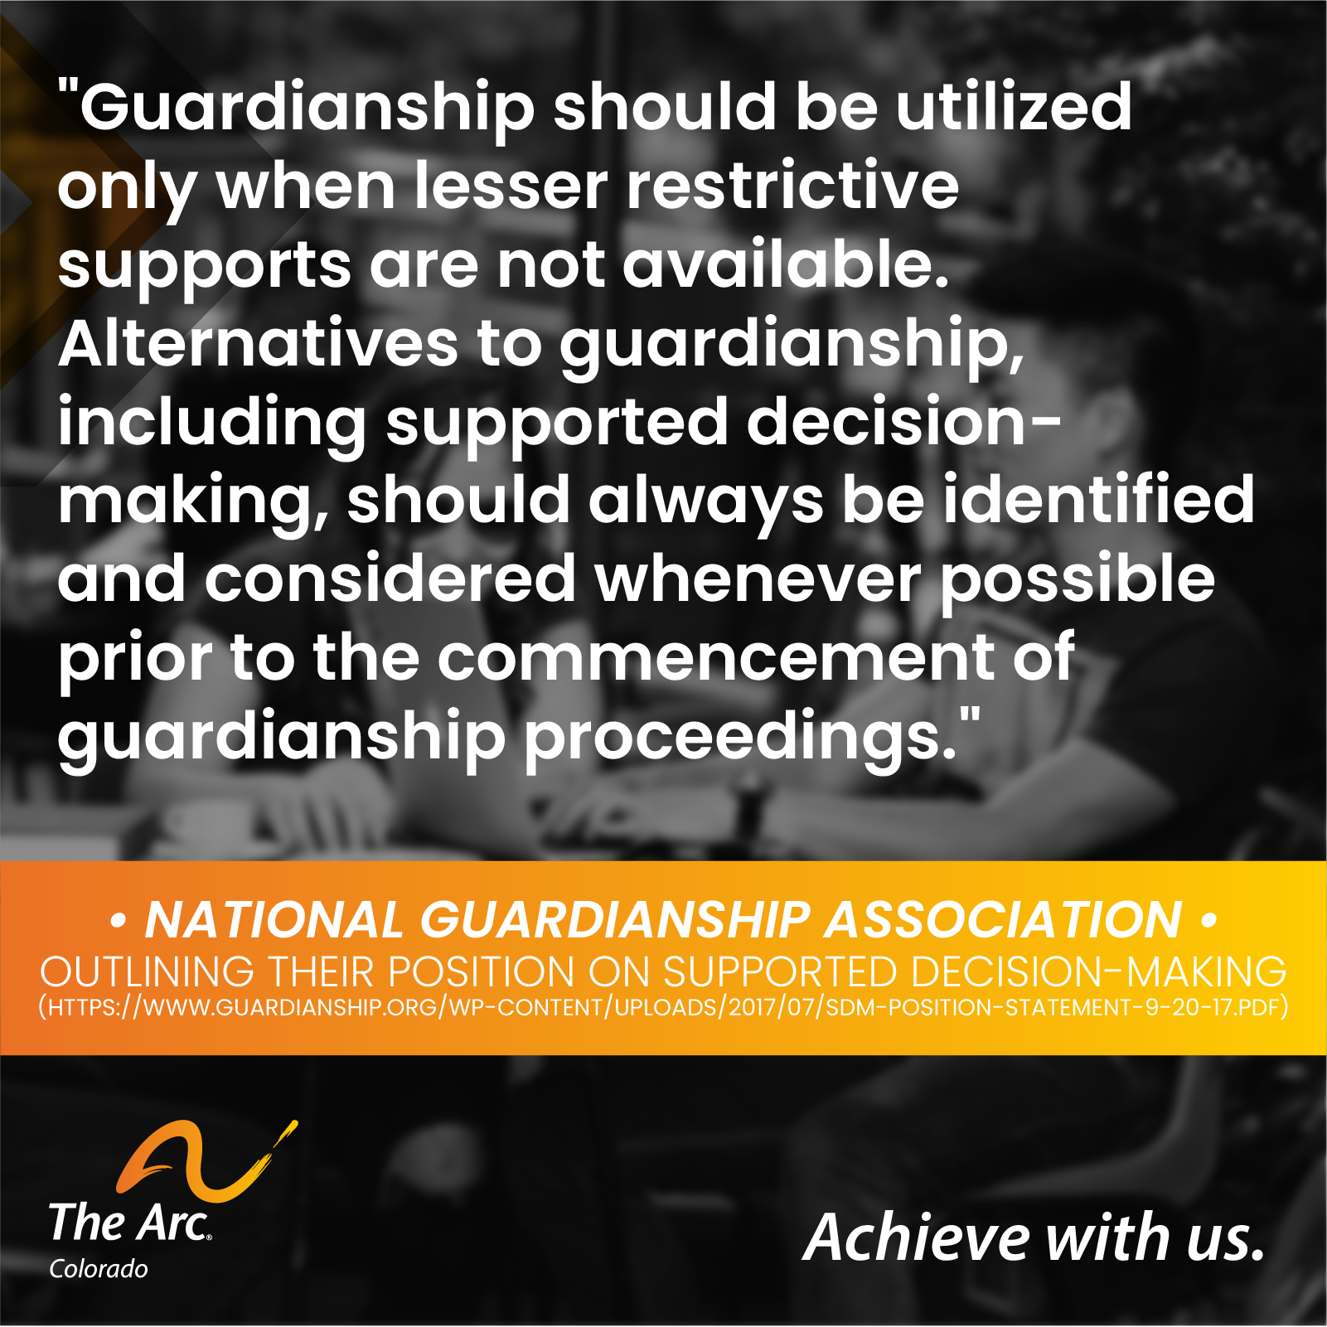
What about a person under guardianship?

Slide 16
Panelists

Slide 17
Panelist Discussion

